Slide 1
Opportunities for Development of Master Course Curricula and Related Research Activities in
Environmental Microbiology & Food Safety at the University of Georgia
Marina Tediashvili, PhD
MENVIPRO project
Erasmus Plus Program
University of Georgia, Tbilisi, October 8, 2019

Slide 2
Who we are and what we do?
Just recently developed Biology and Chemistry direction within the Department of Natural Sciences, School of Science and Technology at the University of Georgia (UG)
Currently providing teaching courses to international students at the UG School of Public health and Medical Sciences ( more then 20 basic courses in biology, and chemistry , including laboratory classes)
Ambitions to develop a number of PhD- and Master courses in selected fields of Biology and Chemistry, also integrated courses in Environmental science.
Team of Microbiologists affiliated with G. Eliava Institute of Bacteriophages, Microbiology and Virology with long- term research experience in various directions of Applied Microbiology and Bacteriophage research

Slide 3
MENVIPRO goals and objectives
Overall objective : to significantly improve the quality of post-graduate studies in the field of Environment Protection in Armenia and Georgia
Utilizing best practice in Europe and in the Partner countries in the field of MSc studies in Environment Protection ( WP1)
– visits to the UNITUS, Ulisbon, UHalle (spring-summer 2019)
Developing/improving curricula for MSc courses including preparation for evaluation and accreditation ( WP2)
Preparation Updating teaching/learning infrastructure ( WP3)
Disseminating the results to entire HE systems in Armenia and Georgia

Slide 4
WP2 -Curricula development (planned for 08.2019-08.2020)
Fourteen (14) Master Courses should be created ( or updated) within the frames of MENVIPRO project
Where we can join development of MSc courses:
Water quality management ( including aquatic microbiology )
Food safety and security
Suggested course - Environmental microbiology
Possibility to be partly involved in the courses :
- Ecological risk assessment; - Environmental toxicology
Developed courses will fit
- National educational standards (accreditation)
- European best practice
- Research-based modern learning technologies
Recommendations for MSc Curricula design produced by MENVIPRO EU partners

Slide 5
Environmental Microbiology MSc curriculum
Environmental microbiology: study of microbial processes in the environment, microbial communities and microbial interactions. Includes water, air and soil microbiology, microbial ecology.
Tentative list of topics to be covered
Microbial communities: structure , function relationships and communal behavior
Microbial interactions and interactions with plants, animals and abiotic factors
Pathogen ecology and environmental epidemiology; Population biology and clonal structure of pathogenic microbes
Comparative genomics of microbial community: functional genomics, environmental metagenomics, bioinformatics analysis
Role of microrganisms in element cycles and biogeochemical processes; Microbe- influenced global changes
Physiological, metabolic and structural diversity of microbes; Responses to environmental signals and stress
Non-culturable microorganisms; VBNC state

Slide 6
Environmental Microbiology MSc curriculum ( cont’d )
Tentative list of topics to be covered
Aquatic and soil microbiomes and climate change
Microorganisms and life in extreme and unusual little-explored habitats
Air Pollution microbiology ; Indoor and outdoor survival and spread; epidemiological aspects
Growth and survival microbes on surfaces, adhesion, biofilm biology
Microbial Communities in Wastewater Treatment Plants
• New technological developments in microbial ecology
Microbial risk assessment, and microbial source tracking
Phage-based monitoring and tracing in water environment; sanation of water reservoirs;
Water treatment technologies: artificial wetlands;
Soil Microbial consortiums: application for the soil remediation
4 weeks field practice, MSc thesis preparation - 4 months ( 1 semester)

Slide 7
Food safety & Security management
A wide spectrum of food safety and quality management issues to be addressed fitting the “ farm to fork” approach.
Indicative list of main subjects ( based on several EU curricula)
Basics of Nutritional Sciences;
Food industry management , economic, financial and safety aspects;
Regulation of Food Production, Quality and Safety; Risk analysis ;
Quality and Safety in Food Technologies (HACCP practice);
Quality Management Systems in the Food Chain, Traceability in the Food Chain
Radiology in food industry
Food Microbiology; Essential Molecular Cell Biology, Microbiological Aspects of Food Quality and Safety;
Food inspection and testing services, national and international control systems; Legislation and private standards;
Food Toxicology , Spectroscopy and Analytical Methods
Antibiotics in food production
Alternative biological approach for prevention microbial contamination and spoilage
4 weeks field practice, MSc thesis preparation (4 months – 1 semester); Food Safety and Quality Management (60 credits) Research Methods (15 credits); Research Project /MSc thesis (60 credits)

Slide 8
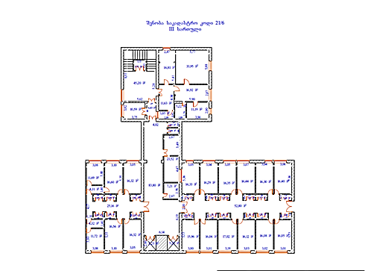
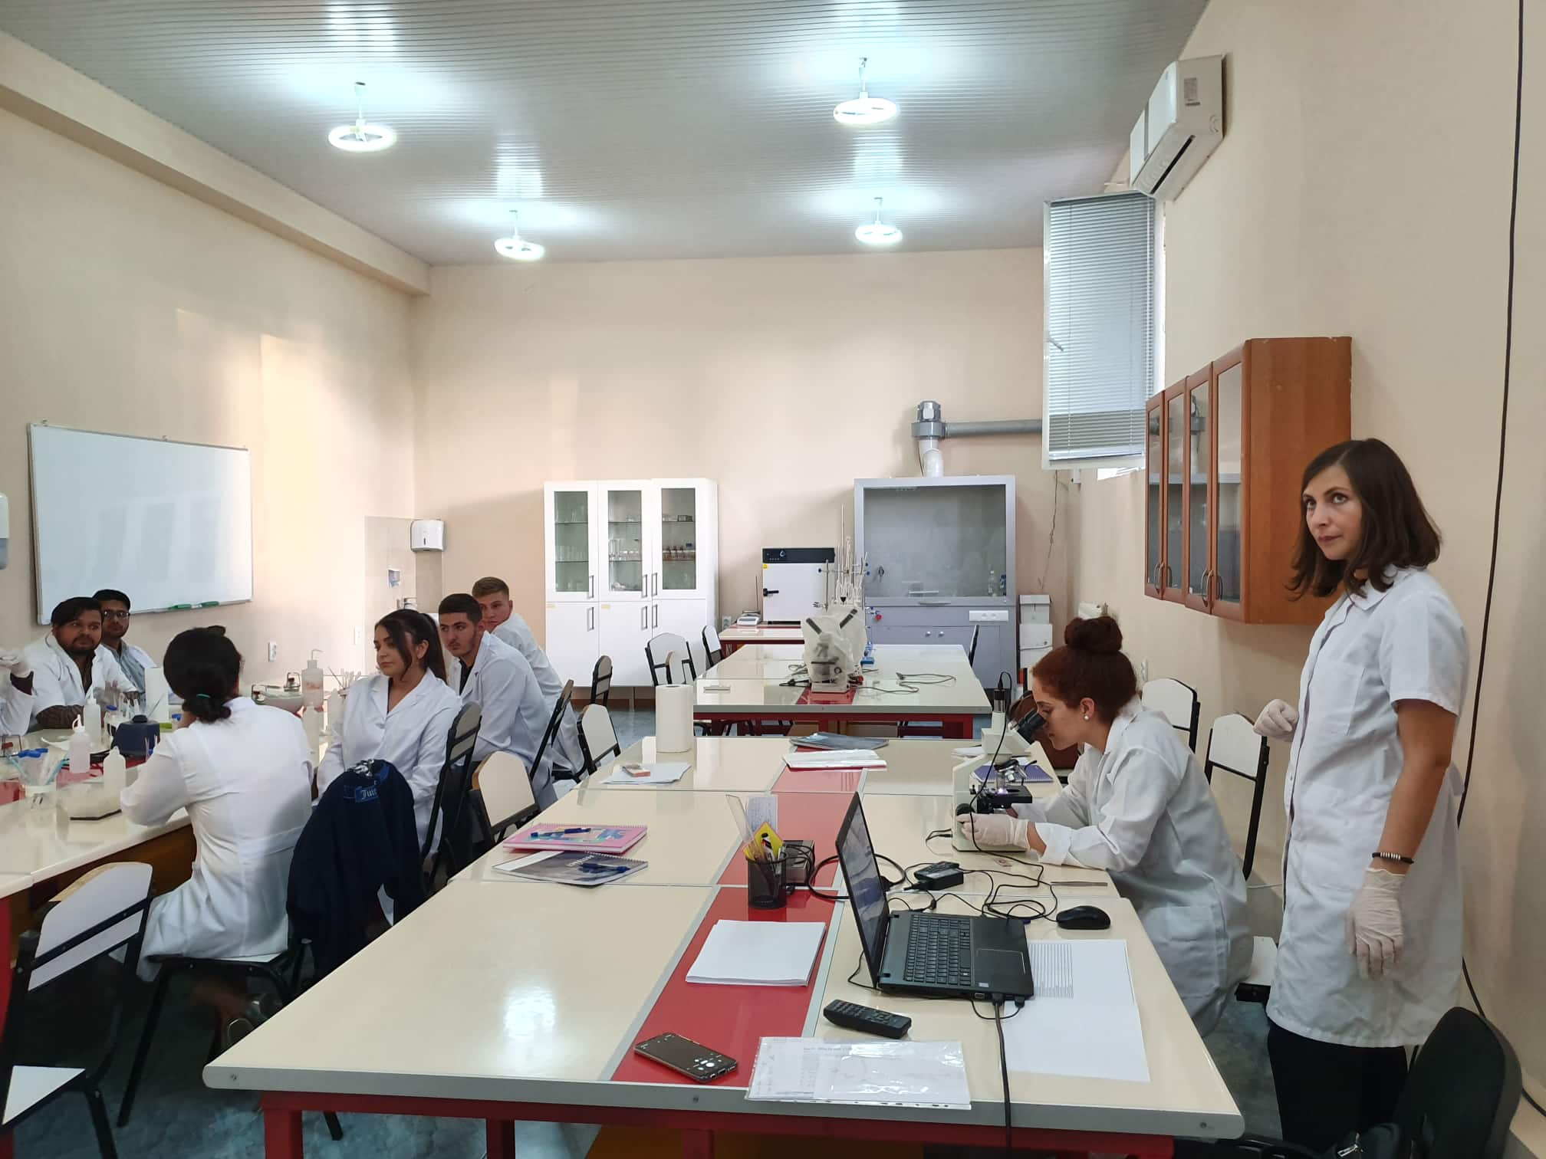
WP3 Innovative learning/teaching/research environments
To establish practice and capacities to develop and deliver MSc curricula in Environment Protection using practice-oriented and technology/research driven approach
Improved infrastructure for practice- and research oriented curricula
What we need :
Improve the infrastructure and technical capabilities
New space ( up to 600 Sq.m) has been allocated for the UG biology and chemistry labs in the Campus of the Eliava Institute.
Currently under reconstruction according to the modern requirements
Microbiology/biochemistry lab at the UG, 1st building ( school of health sciences)

Slide 9
What we need :
Close collaboration with local or regional research institutions through:
- Signing MOU’s with leading institutions
- Hiring teaching staff/lecturers from research labs
- Prepare and implement joint research and educational projects
Organize thematic workshops /trainings
Use technical capabilities ( e.g. high technology equipment) of other labs
G. Eliava Institute of Bacteriophages, Microbiology and Virology: Potential partner in developing and delivery of the planned MSc courses

Slide 10
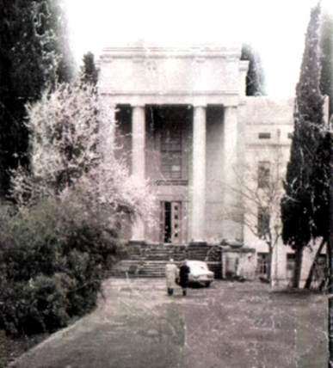
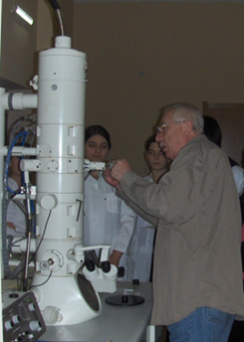
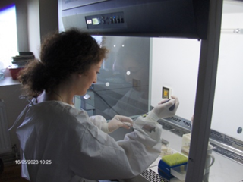
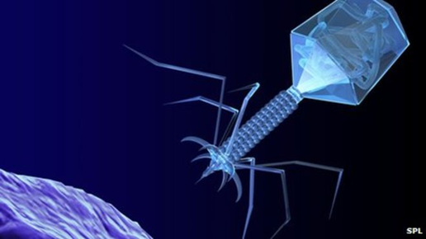
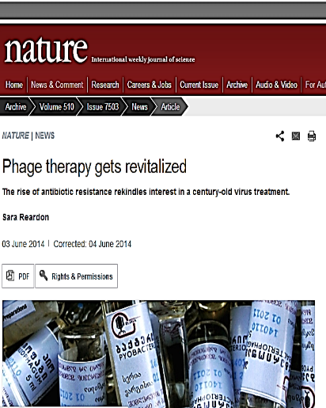
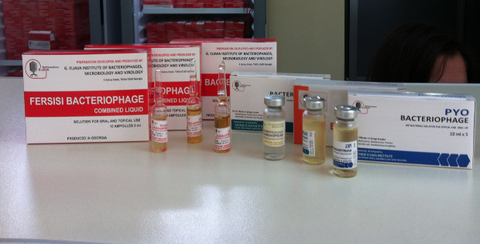
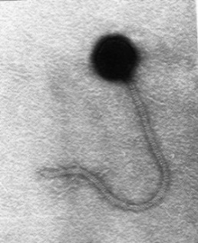
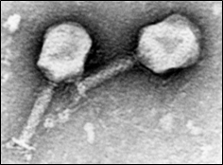
G. Eliava Institute of Bacteriophages,
Microbiology and Virology
World renown institution in the field of phage research/phage therapy
>95 years of expertise in Applied Microbiology
Development and production of a diverse variety of bio-preparations - Bacteriophages, vaccines, immune sera, diagnosticums, antiviral agents, probiotics, enzymes etc
Eliava Institute was established in 1923 in Tbilisi, Georgia by professor George Eliava
BBC NEWS
2014
Phages may be key in bacteria battle

Slide 11
Eliava Institute & Eliava consortium
Eliava Consortium
Eliava learning center
ELIAVA
Media production
ELIAVA Institute
Research
Education
ELIAVA
Foundation
Eliava authorized
Pharmacy
Eiava
Diagnostic center
Eliava
Biopreparations
Eliava
Phage Therapy

Slide 12
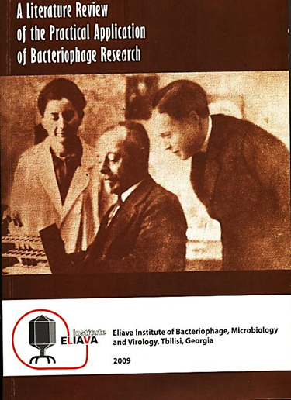
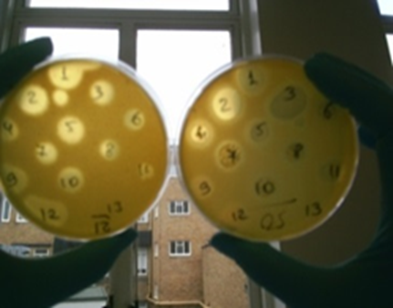
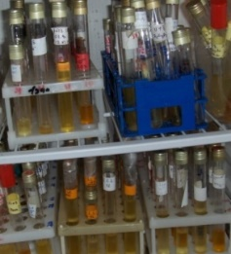
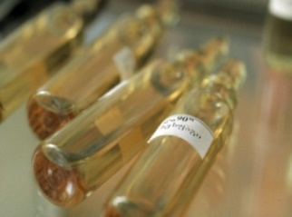
Main fields activity of the Eliava Institute
Public Health and Medicine, Medical Microbiology, infection control ( therapy and prophylaxis)
Veterinary medicine
Plant protection
Environmental health /environmental protection
Environmental Microbiology
Food Microbiology
Food safety
Phage biology and phage –based practical applications
Largest phage collection
- up to 2000 phages
- active to 36 genera and 95 species of bacteria

Slide 13
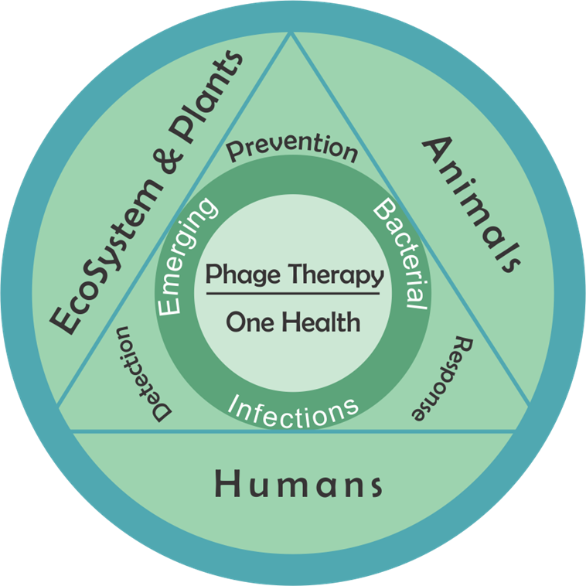
Bacteriophages in relation to the “One World - One Health “concept
Phages for human health: individual therapy and massive therapeutic and prophylactic applications;
-Infection control in hospitals
Phages in Animal health, Anthropozoonoses
Infection control in cattle and poultry
Phages for antibitoc-free Sustainable aquaculture
Aquatic Ecosystems : role of phages/viromes in aquatic microbial diversity
Phage –based monitoring and control of pollution
Phages in plant health – way to bioagriculture
“One World - One Health” concept is a worldwide strategy for expanding interdisciplinary collaborative efforts in all aspects of health care for people, animals and the environment.

Slide 14
Applied aspects of phage ecology
Phages as indicators of microbial pollution and /or presence of particular pathogens
Phage amplification assay for pathogen detection in environment
Phages as tracers for identification of pollution source and spreading ways
Phage typing technique as a tool for bacterial sub typing and epidemiologic differentiation
Potential of phage application for treatment/ sanation of water sources
Use of phages for reducing/eradication of microbial contamination in closed indoor environments
Use of phages for prevention and eradication of health care associated infections( HAIs
Use of phages for infection control in aquaculture

Slide 15
Research projects implemented on the topics of interest ( 2000-2019)
Environmental science/environmental microbiology/microbial diversity
Microplankton and biomass fluctuation in the marine ecosystems (EU INTAS 99-1930)
Evaluation of bioindicators and pollution status of the Black Sea coastal zone (EU INTAS 01-788)
Elaboration of phage amplification assay for the detection of Bacillus anthacis in the environment (US CRDF CGP Gb2-2497)
Macromolecular and biophysical characterization of bacteriophage tracers for water resources ( NATO clg 04)
Ecology and biology of selected vibrios and their bacteriophages in aquatic environments of Georgia ( US DTRA GG-13)
Phage mediated antibiotic resistance gene transfer in marine, freshwater and extreme environments (US CRDF A60920)
Viruses in the Black Sea: diversity, community dynamics and virus –host interactions” (SRNSF N17442 )

Slide 16
Research projects implemented on the topics of interest (2000-2018) Cont’d
Food safety /Ecofriendly technologies
Elaboration of the new, phage – based strategy for control of potato bacterial infections (US CRDF NSTM Gb2-527)
Prevention of food spoilage and growth of pathogenic microflora by biologically active substances of plant origin (EU INTAS 00-727)
Control of Crown-gall disease in grape: Integration of Biological Control with Transgenesis (US‑ISR CDR-CAR CA23-037)
Bacteriophages for the control of diseases in Mediterranean cultured fish (HCMR-El 01)
Network for the development of phage therapy in aquaculture –AQUAPHAGE ( FP7 MC PIRSES 269175)
Biocontrol of a carantine organism - Phytopathogenic bacterium Ralstonia solanacearum” (SRNSF #460)
Phage –based environmentally safe strategy for infection control in cultured freshwater fish (STCU-SRNSF 6209)

Slide 17
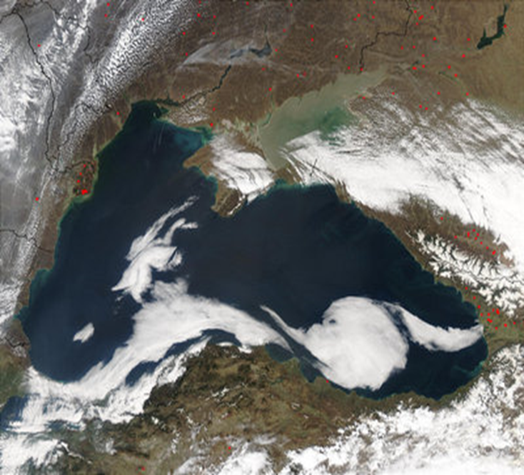
Main environmental problems in the Black Sea coastal zones
Black Sea studies ( 200-2019)
Anthropogenic impact
- Accumulation of various pollutants (including hydrocarbons, heavy metals, pesticides )
- Euthrophication of surface waters
- Structural changes in marine biocenosis
(introduction of non- indigenous species)
The role of Climate change:
- Increasing air and sea water temperature
- Increased frequency of heavy rainfalls, storms, flooding
- Reduction of populations of fish and mussels
- Increased microbial pollution
- Correlation with increase in frequency of diarrheal diseases
Satellite view of the Black Sea
*Climate change strategy in Adjara. UNDP in Georgia. 2013

Slide 18
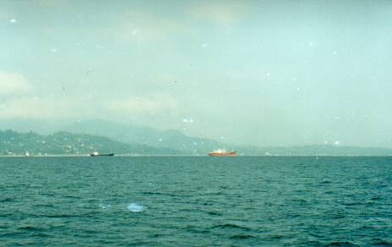
Phage Tracing in water environment: Studies in Batumi aquatoria
Properties of the tracer phages resemble those of infectious agents (pathogenic bacteria and viruses).
The water course can be traced over long distances (>20 km);
The low detection limit for phages is comparable to that for chemicals;
Phage tracers were used to determine contamination source and its transmission ways
- Risk assessment of swimming associated infections
- Impact of ballast waters from ships
Evaluation of the effectiveness of waste water treatment plants
Insufficiently purified urban municipal, domestic and industrial effluents, surface runoffs
Introduction of non - indigenous, potentially harmful species
I.Chkonia et al, 1988; 1997; Janelidze et al, 2009
Balast water and Waste from ships
Spreading of bacterial, viral or protozoan infections

Slide 19
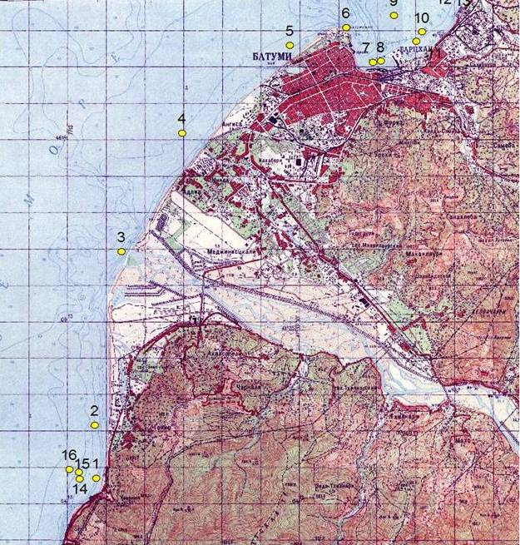
Seasonal monitoring of microbial quality in
Batumi aquatoria of the Black Sea ( 2002-2005)
Seasonal variability of microbial quality indices in Batumi city area;
- TBC; THC; TCC; FCC; ENT; Chla
Highest level of microbial contamination of sea water in summer season.
Abundance of indicator somatic phages in sea water - proportional to total bacterial count (TBC).
Distinct ( clear and polluted) zones in Batumi aquatoria: Gonio- Kwariati and Bartskhana
Variable Intermediate zone in Batumi city area
Bartskhana
BATUMI
G0-KW
Map of Batumi coastal area
INTAS 01-788

Slide 20
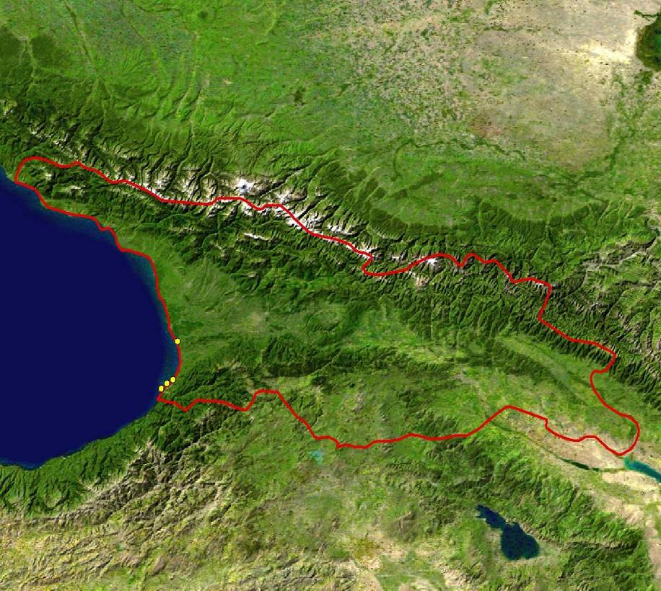
Studies in the Black Sea Coastal Zone of Georgia
Seasonal monitoring in the Black Sea Coastal zone
Studies conducted in 2 series:
2006-2009
2015- 2016
Black Sea
Georgia
On site measurement of physical –chemical parameters (temperature, DO, salinity, pH, TDS)
Microbiological analysis of water and sediment samples
Sampling at 4 points
Chorokhi Estuary
41⁰ 36’ 176’ N
41⁰ 34’ 108’ E
Batumi Bulvard
41 ⁰38’ 552’ N
41⁰ 37’ 617’ E
Green cape
41⁰ 44 142’ N
41⁰ 41 480’ E
Supsa Estuary
42⁰ 00’ 773’ N
41⁰ 45’ 059’ E

Slide 21
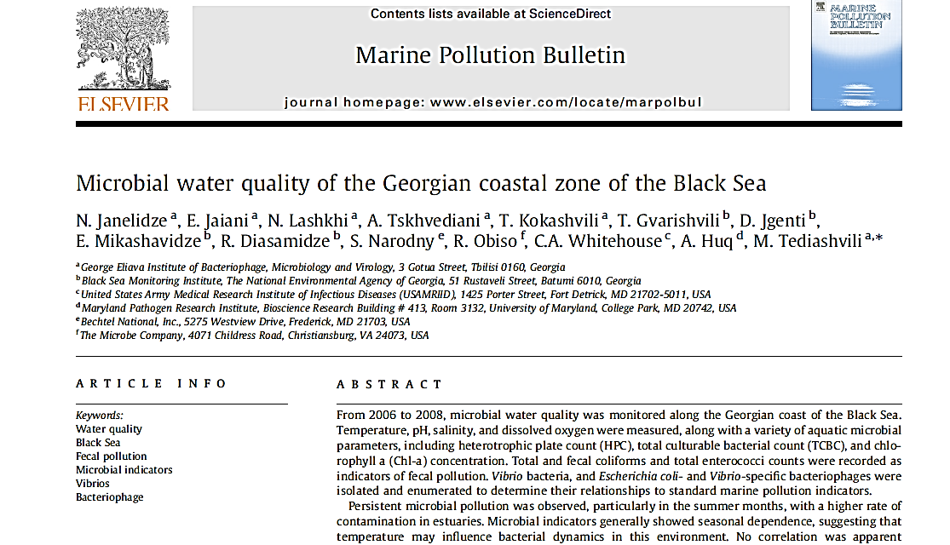
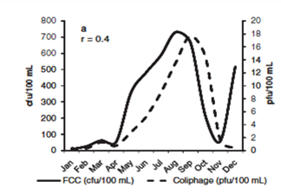
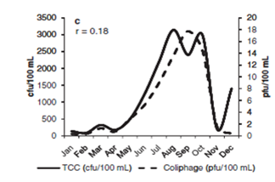
Microbial indices of Water quality in the Black Sea coast of Georgia
Seasonal variability of majority of water microbial quality indices
Increased pollution level at all sites in warm season
Higher levels of microbial contamination in estuaries (Chorokhi and Supsa sites)
Aquatic microbial parameters (TBC, AC, HPC), also Fecal pollution indicators (TCC, FCC, Ent ) and somatic coliphages showed positive dependence on temperature
Janelidze et al., 2011. Mar. Poll. Bul., 62, p.573-580.

Slide 22
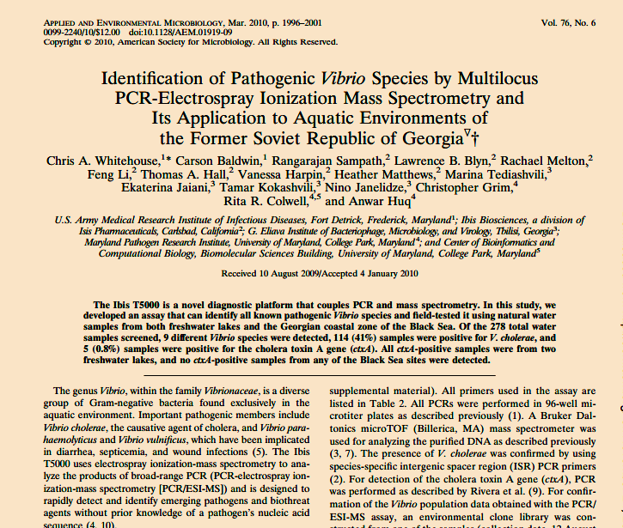
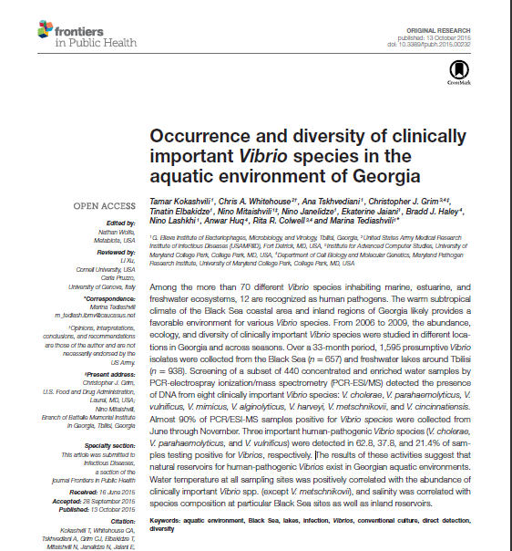
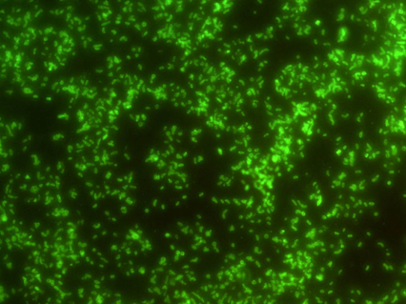
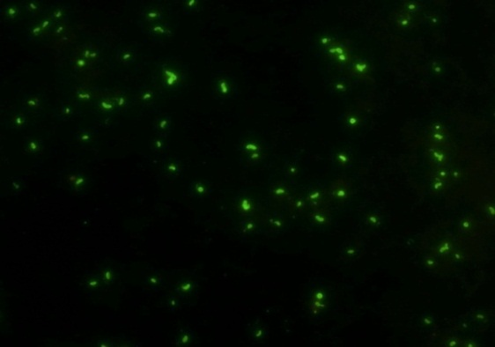
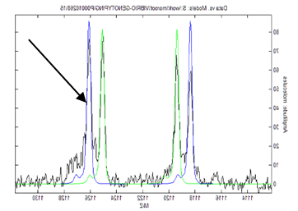
Human pathogenic vibrios in the Black Sea coastal zone of Georgia
.
Direct detection of Vibrio spp
2007-2010 - Determination of the full spectrum of Vibrio genomes in the water samples (total DNA’s)
“Tiger” Platform - Multilocus PCR / ionization electro spray- mass spectrometry (PCR/ESI-MS)
Focus on 12 human-pathogenic vibrio species
Direct detection of epidemic serotypes of Vibrio cholerae in water samples
- Direct Fluorescent Antibody (DFA) Assay
V. cholerae O1 positive DFA samples - Green cape and Chorokhi, July 2008

Slide 23
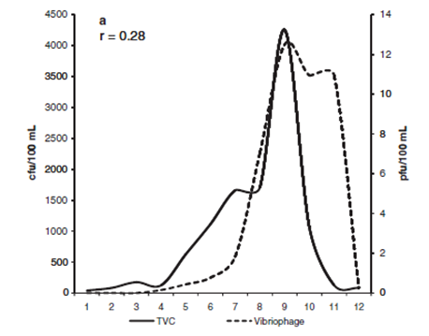
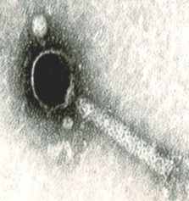
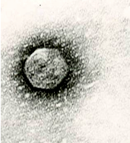
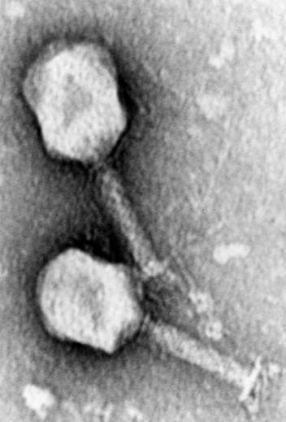
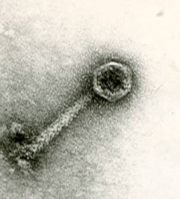
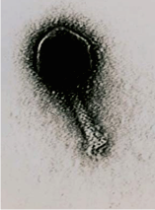
Phages active to autochtonous bacteria in the Black Sea coastal waters of Georgia
Aquatic phages - predictive or retrospective indicators for presence of corresponding bacteria
V.parahaemolyticus - specific phage isolation dynamics showed seasonal character and followed the fluctuations of the host bacteria
Vibrio- and Aeromonas- specific phages (TEM)
Distribution of Vpa phages by sampling sites
The Phage pool in the Black Sea environment – valuable resource of candidate phages for therapeutic preparations

Slide 24
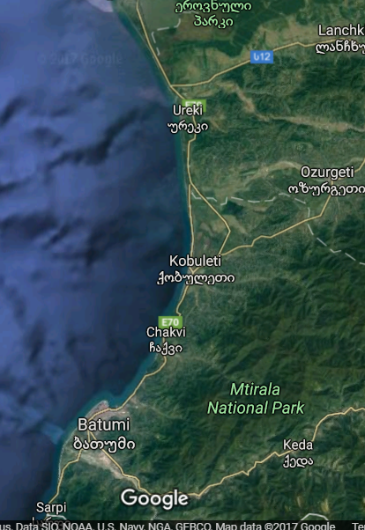

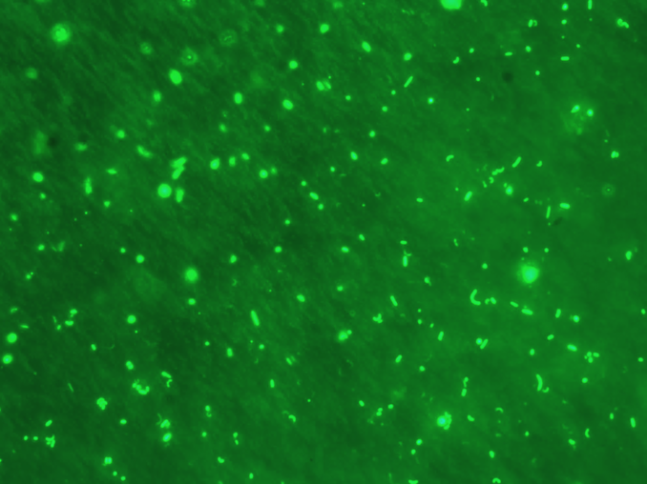
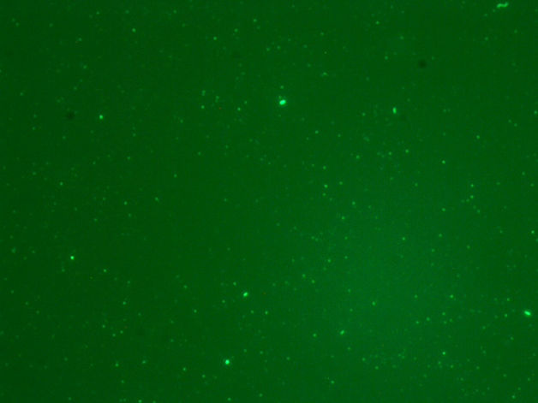
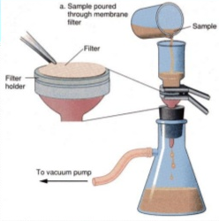
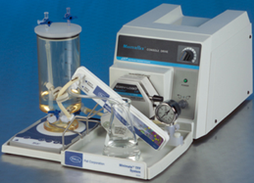

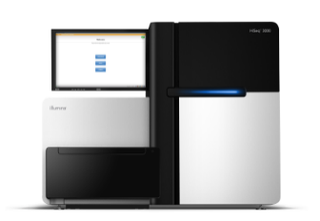
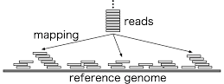
Microbial communities in the Black Sea ( Georgian coastal zone) -2015-2017
Counting prokaryotes, protists, virioplankton
Epifluorescent microscopy
Zeiss Axioscope 40
Syber green staining
Diversity of viruses by TEM
Metagenomic approach
Sampling- Concentration – DNA Extraction- Sequencing - Annotation
Abundance of bacteria
– 10⁵ -10⁶ cell ml⁻¹
Abundance of phages
– 10⁶ -10⁷ cell ml⁻¹
Project CRDF 6209

Slide 25
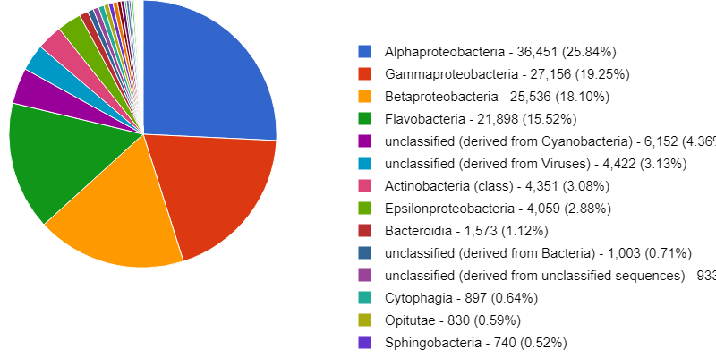
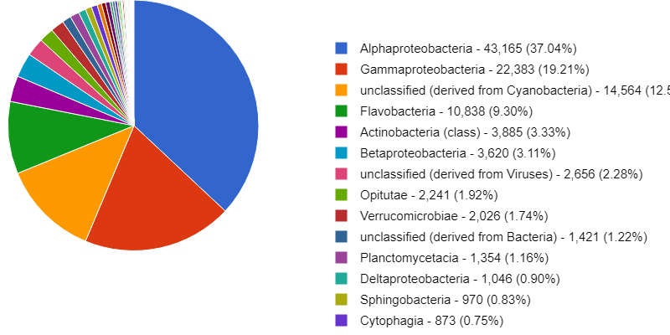
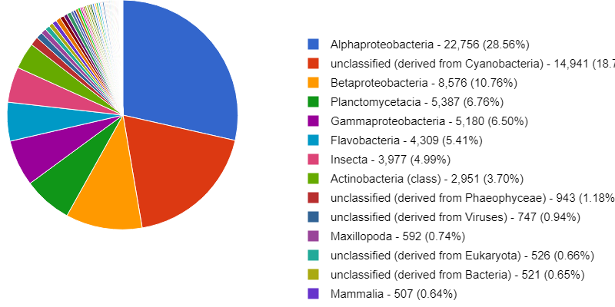
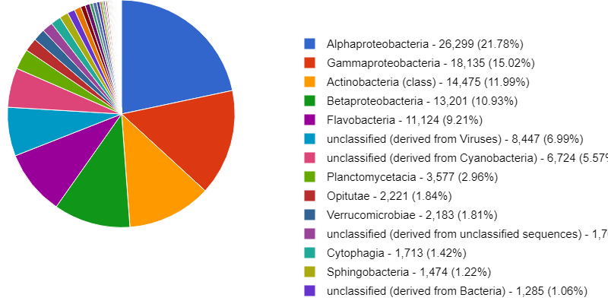
The Black Sea Microbial Diversity
Aphaproteobacteria dominated at all 4 sites,
followed by Gammaproteobacteria ( except GC)
Supsa Estuary
Batumi Boulevard
Green Cape
Chorokhi Estuary

Slide 26
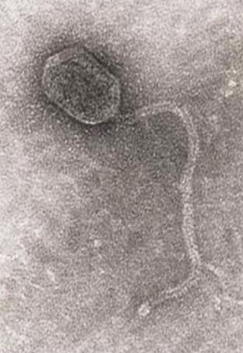
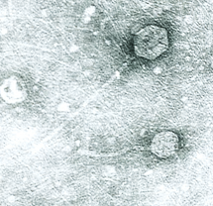
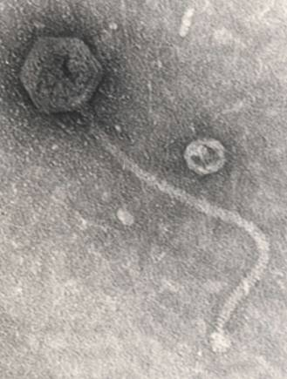
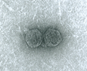
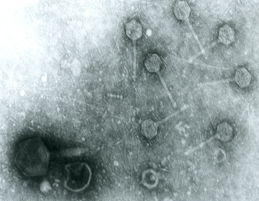
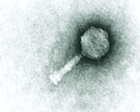
The Black Sea virome – Phage morphology
Batumi Boulvard
Green Cape
Bar=100nm

Slide 27
The Black Sea viruses
Green Cape
Batumi Boulvard

Slide 28


Phage community in the Black Sea coastal zone
Metagenomic analysis
Batumi Boulevard site
Correlation with the metagenomic data on abundance and composition of bacterial community
Phages to a number of prevalent bacteria have been isolated from the BS waters: Acinetobacter, Aeromonas, Vibrio spp., Pseudomonas etc

Slide 29

Antibiotic resistance in the Black sea Microbial community
Metagenomic analysis
AMR genes were revealed only at 2 Black Sea sites : Batumi Boulevard and Chrokhi estuary
Higher content of AMR genes in winter samples

Slide 30

THANK YOU!
Acknowledgement
Dr. Ekaterine Jaiani
Eliava Institute of Bacteriophages
Collaborators :
University of Maryland
Michigan State University

